Slide 1
430.211 Programming Methodology (프로그래밍 방법론)
Taesup Moon
Department of Electrical and Computer Engineering
Seoul National University

Slide 2
Outline
Chapter 7: Constructors and Other tools
Constructors
More tools

Slide 3
Ch 7. Constructors and Other Tools Learning Objectives
Constructors
Definitions
Calling
More Tools
The const parameter modifier
Inline functions
Static member data
Vector

Slide 4
Constructors
Initialization of class objects
Initialize some or all member variables
Other actions possible as well
A special kind of member function
Automatically called when object is declared
Very useful tool
Key principle of OOP

Slide 5
Outline
Chapter 7: Constructors and Other tools
Constructors
More tools

Slide 6
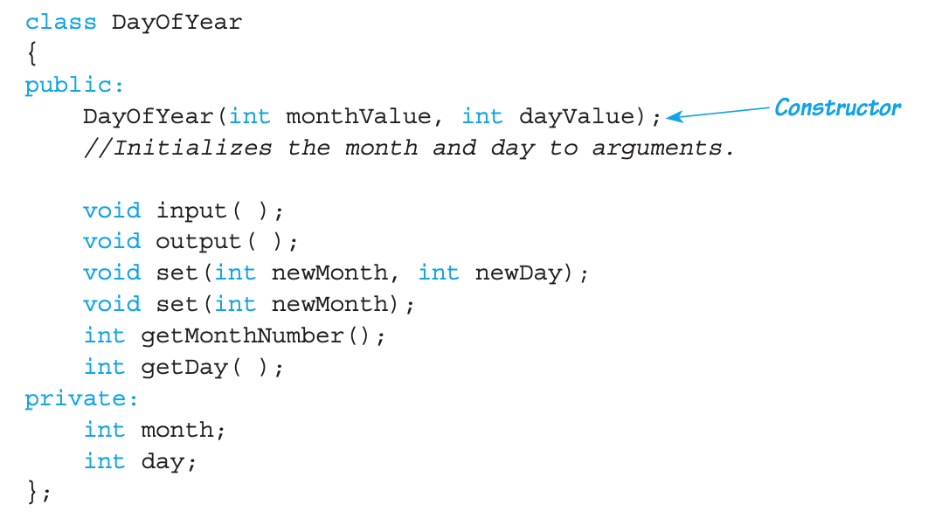
Constructor Definitions
Constructors are defined like any member functions
Except that they
Must have the same name as the class
Cannot return a value; not even void!

Slide 7
Constructor Note
Constructor is placed in the public section
It is called when objects are declared
If it were in the private section, you cannot declare any objects!

Slide 8
Calling Constructors
Declare objects:
Objects are created here
Constructor is called
Values in parentheses are passed as arguments to constructor
Member variables month, day are initialized: date1.month → 7 date2.month → 5 date1.day → 4 date2.day → 5

Slide 9
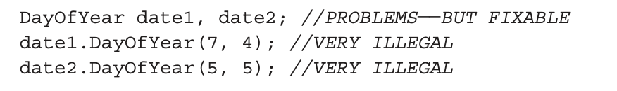
Conceptual Equivalency of Constructors
Consider:
Conceptually equivalent, but…
CANNOT call constructors like other member functions!

Slide 10
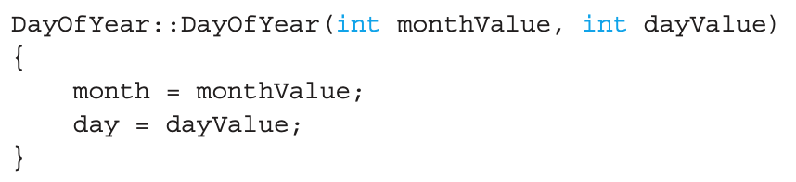
Constructor Definition
Constructor definition is like all other member functions:
Note the same name around ::
Clearly identifies a constructor
Again, note no return type
Just as in class definition
Class name
Constructor name

Slide 11
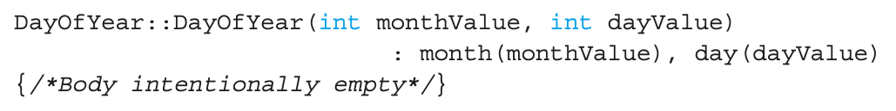
Alternative Definition
Previous definition equivalent to:
Body may be left empty
Initialization Section

Slide 12
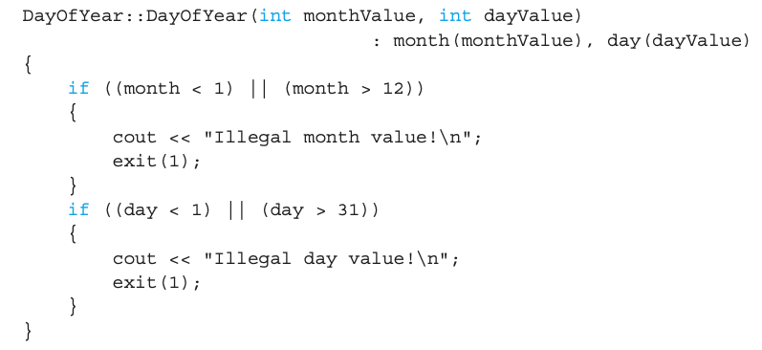
Additional Purpose of Constructors
Not just for initializing the data
Body doesn’t have to be empty
You can validate the data! → Ensure only appropriate data is assigned to class private member variables

Slide 13
Overloaded Constructors
Can overload constructors just like other functions
Recall that a signature consists of:
Name of function
Parameter list
May provide constructors for all possible argument-lists
Particularly "how many"

Slide 14
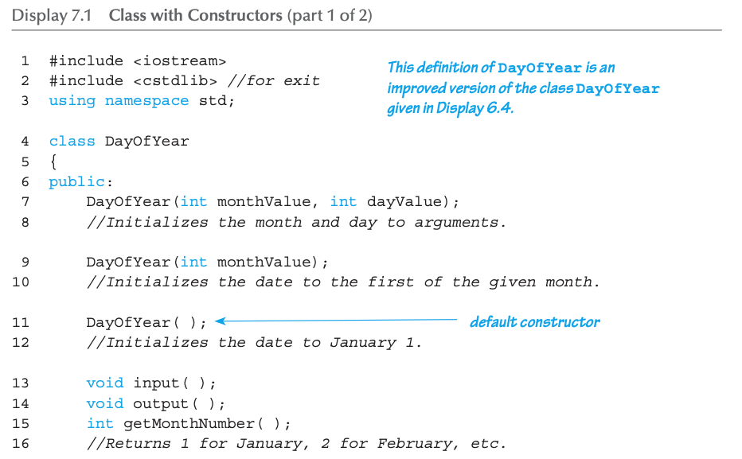
Class with Constructors Example: Display 7.1 Class with Constructors (1 of 3)
Overloaded constructors!

Slide 15
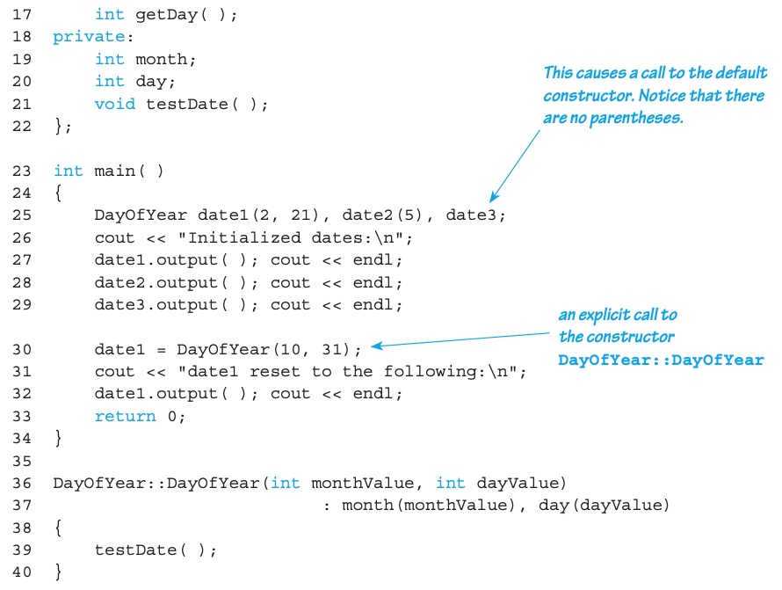
Class with Constructors Example: Display 7.1 Class with Constructors (2 of 3)

Slide 16
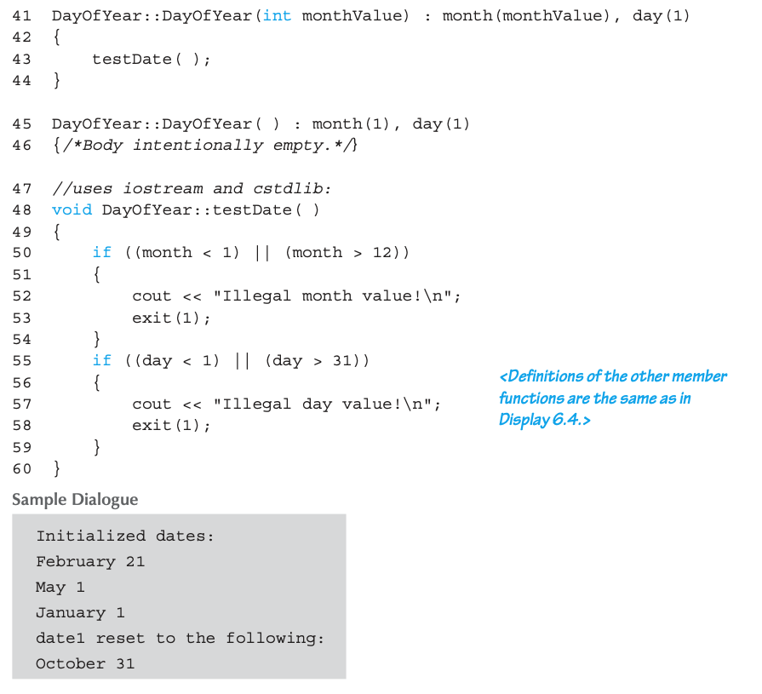
Class with Constructors Example: Display 7.1 Class with Constructors (3 of 3)

Slide 17

Explicit Constructor Calls
Can also call constructor again
After object declared
Can call via object’s name; standard member function call
Create & initialize an anonymous object and assign it
Holiday=DayOfYear(); (Needs the parentheses!)
Convenient method of setting member variables
Method quite different from standard member function call (e.g., no return type etc.)

Slide 18
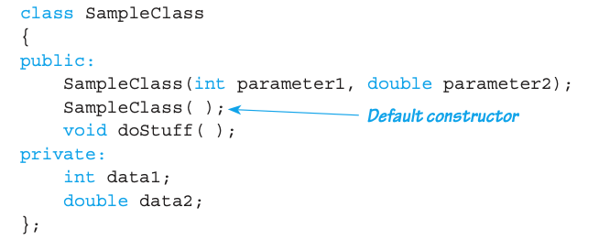

Default Constructors
Constructor with no arguments
Make it a practice to always include the default constructor
If no constructors defined, a default constructor doing nothing will be automatically created
Otherwise (i.e., if other constructors exist), if you want to declare like SampleClass myVar; you need to define a default constructor

Slide 19
See Display 7.2

Slide 20
Class Type Member Variables
Class member variables can be any type
Including objects of other classes!
Type of class relationship
Need special notation for constructors
So they can call "back" to member object’s constructor

Slide 21
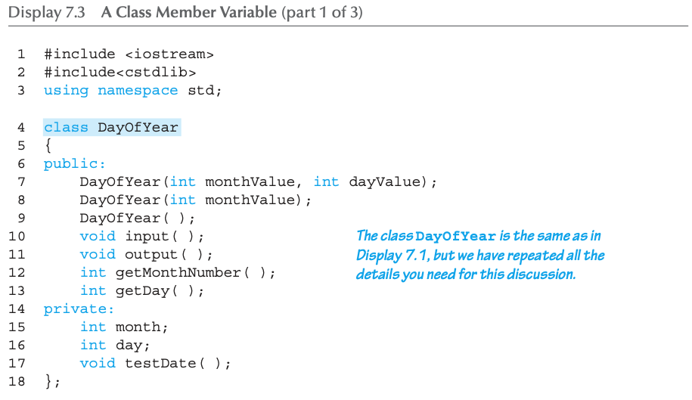
Class Member Variable Example: Display 7.3 A Class Member Variable (1 of 4)

Slide 22
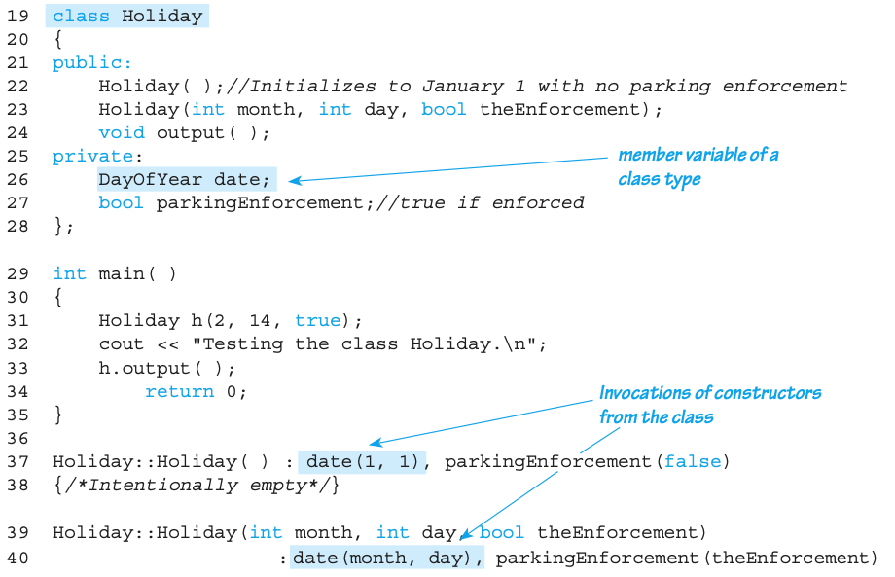
Class Member Variable Example: Display 7.3 A Class Member Variable (2 of 4)

Slide 23
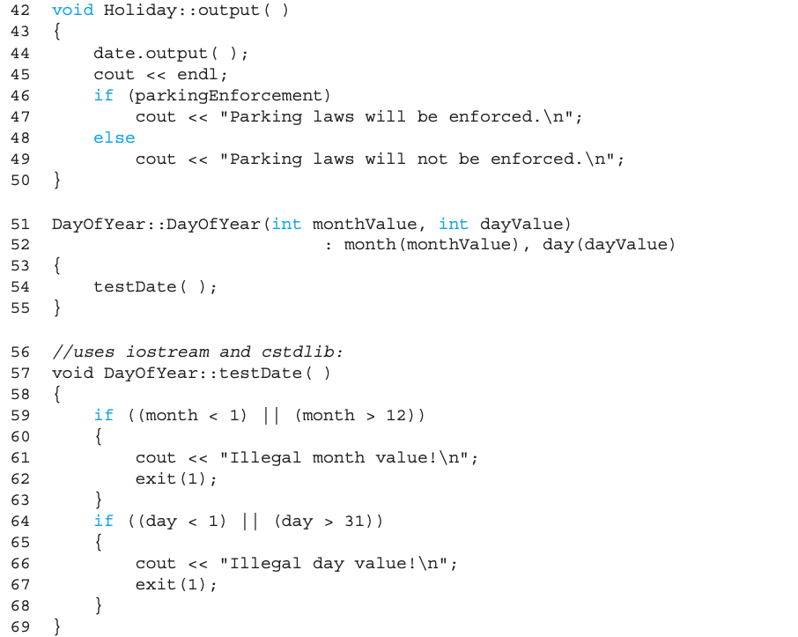
Class Member Variable Example: Display 7.3 A Class Member Variable (3 of 4)

Slide 24
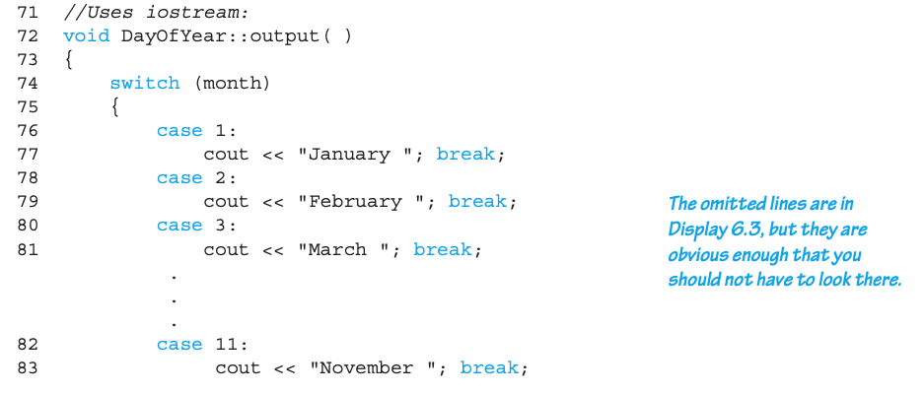
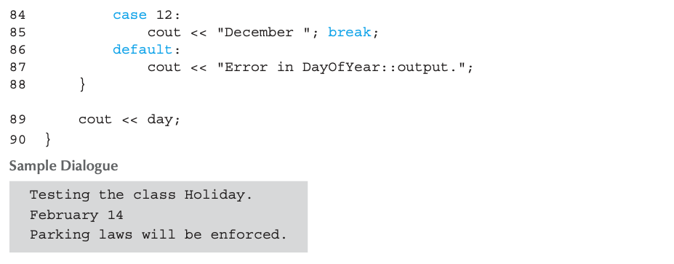
Class Member Variable Example: Display 7.3 A Class Member Variable (4 of 4)

Slide 25
Outline
Chapter 7: Constructors and Other tools
Constructors
More tools
Const
Inline function
Static members
Vector

Slide 26
Parameter Passing Methods
Efficiency of parameter passing
Call-by-value
Requires a copy to be made
Negligible overhead for int or double, but can be significant for passing class objects
Call-by-reference
No need to copy the argument
Clear advantage for class types (that have many member variables)
It makes sense to use call-by-reference for a class
Even when the function does not change the parameter!

Slide 27
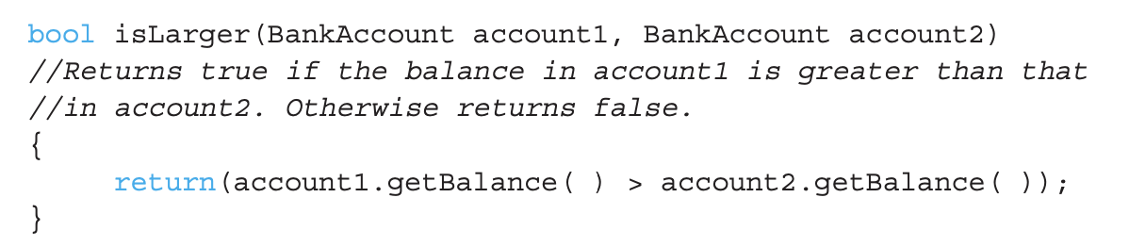
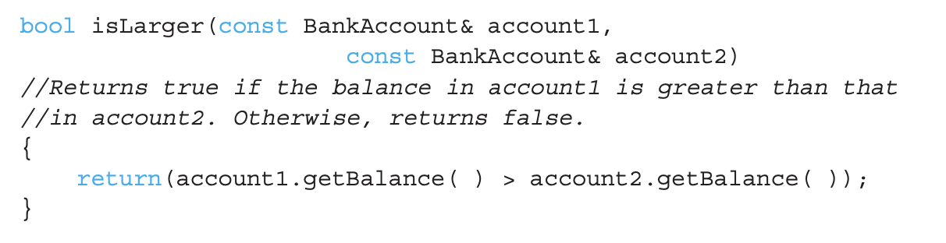
The const Parameter Modifier
Compare the following two examples
When the function does not change the parameters, the second one is a clear winner

Slide 28
The const Parameter Modifier
Can protect the argument for call-by-reference
Use constant parameter
Also called constant call-by-reference parameter
Place keyword const before type
Makes parameter "read-only"
Attempt to modify parameter results in a compiler error → automatic error checking

Slide 29
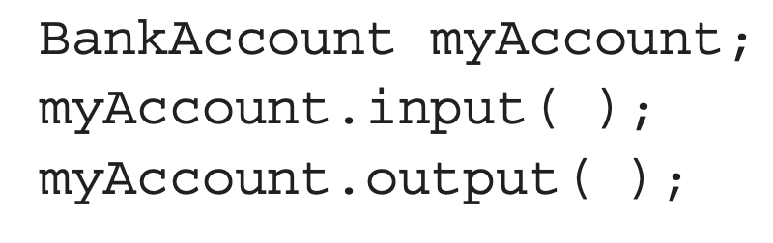
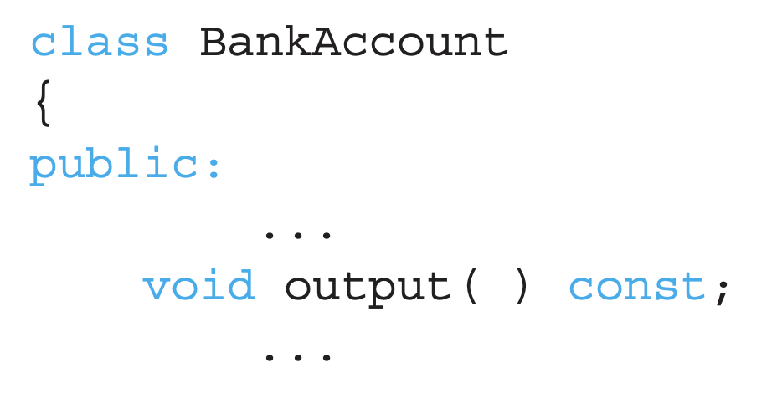
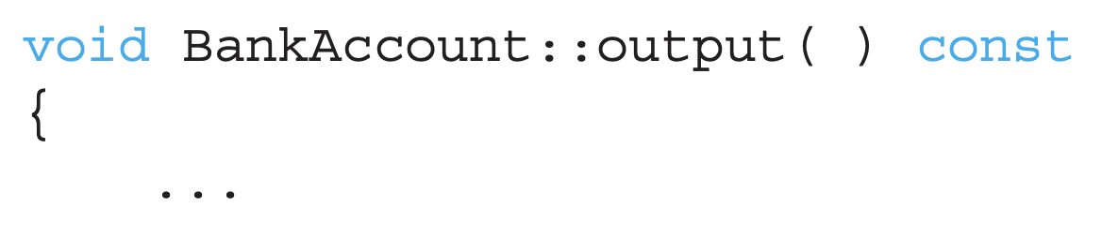
const Modifier for Functions
Consider the example
The member function input() can change the member variable as well
What if you do not want to change the member variable by calling a member function?
Marking a function with a const modifier
Error if the function code inadvertently changes the value
[Declaration]
[Definition]

Slide 30
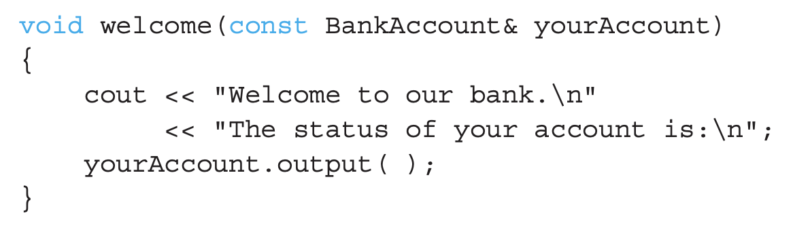
[Pitfall] Inconsistent use of const
const is an all-or-nothing proposition
If a const is used for a class type, then every member function that does not change the member variables should also have the const modifier
Reason: function calls within function calls
If output() does not have the const modifier, the compiler will give an error message!

Slide 31
Three Uses of const
1) const double pi = 3.14159;
2) void display(const Student &a);
3) class Student { public: void show() const; → show() function cannot change any member variables of the Student class … };
Global variable, parameter, function modifier

Slide 32
Inline Member Functions
Class member function definitions
Typically defined separately
But it can be defined IN the class definition
Makes function "in-line”
Compiler inserts the definition at each location where the function is invoked → efficient for short definitions
Disadvantages also exist
Mixing the interface and implementation
Inline functions can only be called in the same file as the one in which it is defined
Less efficient for long definitions

Slide 33
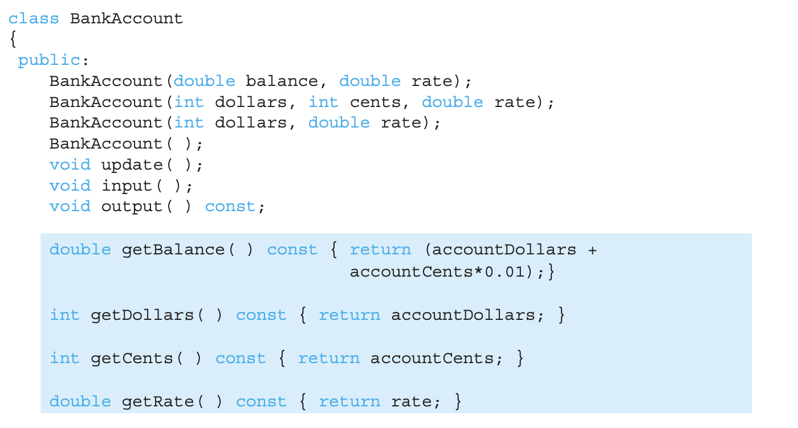
Example of Inline Member Function

Slide 34
Static Members
Static member variables
All objects of the class "share" only one copy
One object changes it → all can see the change
Similar to global variables, but only for the objects of the class
Useful for "tracking"
How often a member function is called
How many objects exist at a given time
Place keyword static before type

Slide 35
Static vs. Nonstatic members
class A { public: private:
static
A a1; public: private:
A a2; public: private:
A an; public: private:
ONLY one copy
static
static
static

Slide 36
Static Functions
Class member functions can be static
It cannot access the object’s non-static variable data
It can only access the static data/function of the class
Non-static member function can also access static variables of the class
Then it can be called outside the class in two ways:
From non-class objects:
E.g., Server::getTurn();
As well as via class objects
Standard method: myObject.getTurn();
Every static variable must be initialized outside the class definition – only once!

Slide 37
Example of Static Members
class Course { public: Course() { num_courses++; } static int getNumCourses() { return num_courses; } … private: static int num_courses; int num_students; int ID; … };
int Course::num_courses = 0;
…
int main(void) { Course math, biology, physics; … cout << “The number of courses are: ” << Course::getNumCourses(); … }
Similar to global variables, but safer

Slide 38
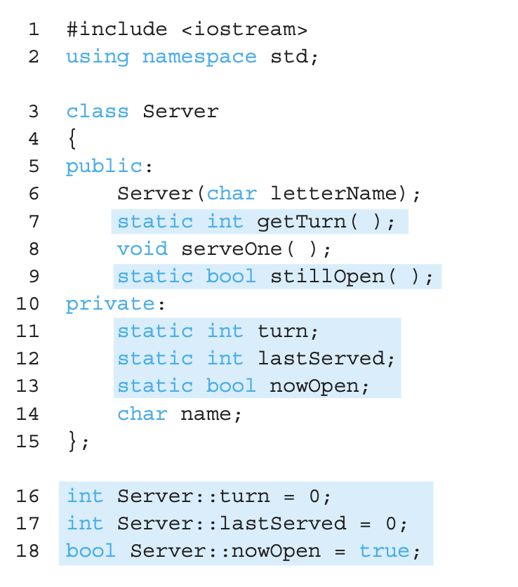
Static Members Example: Display 7.6 Static Members (1 of 3)
Initialization of static member variables

Slide 39
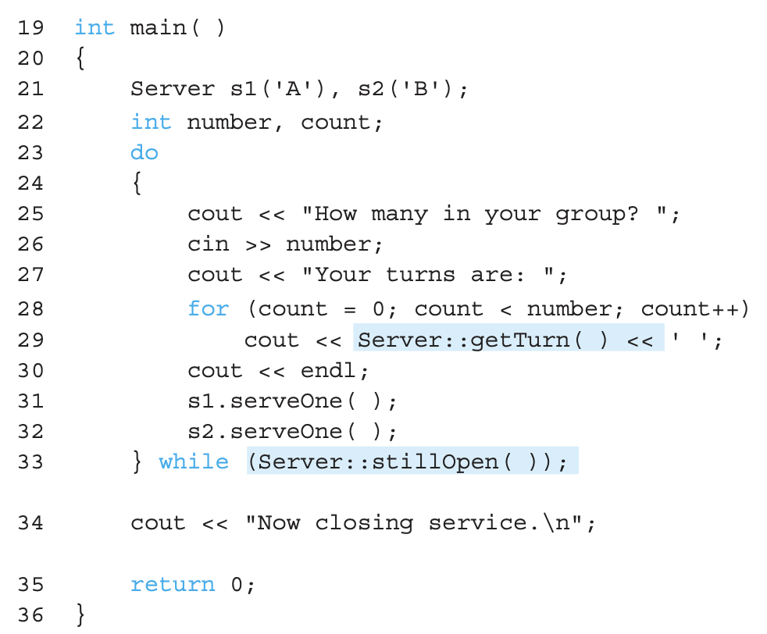
Static Members Example: Display 7.6 Static Members (2 of 3)

Slide 40
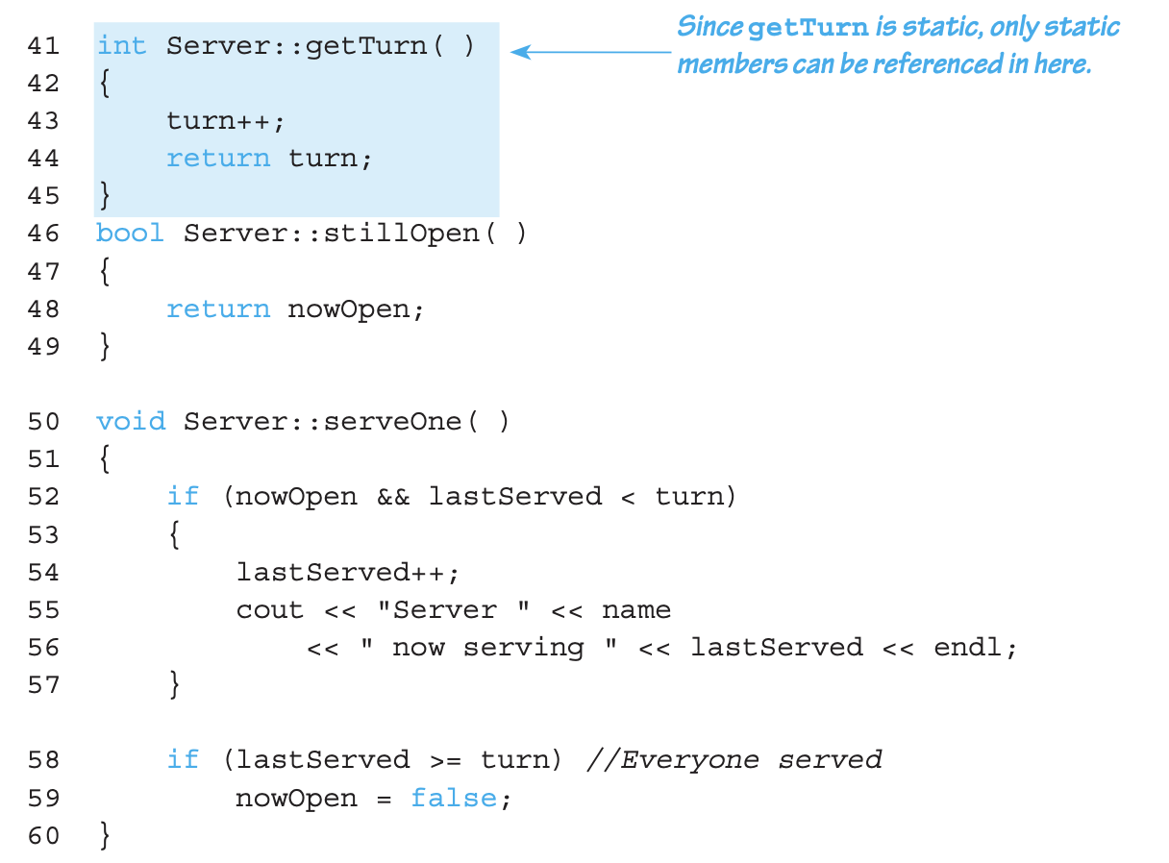
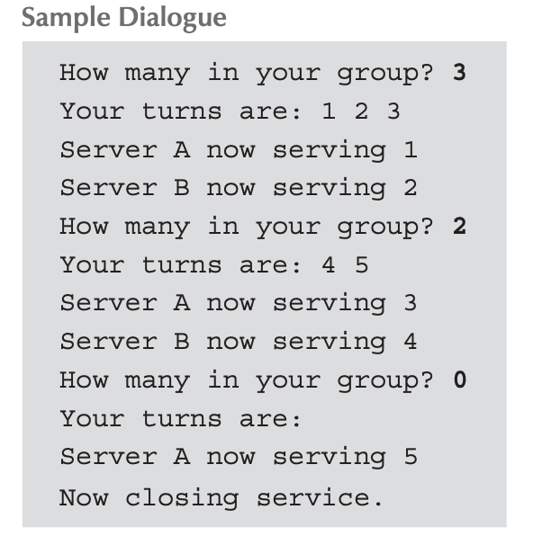
Static Members Example: Display 7.6 Static Members (3 of 3)

Slide 41
Vectors
Vector Introduction
Recall: arrays have fixed size
Vectors: "arrays that can grow and shrink"
During program execution
Formed from Standard Template Library (STL)
It uses class template (we will study details in a later lecture)

Slide 42
Vector Basics
Similar to array:
Has a base type (can also be class types)
Stores collection of base type values
Declared differently:
Syntax: vector<Base_Type>
Indicates class template
Any type can be "plugged in" to Base_Type
Produces a "new" class for vector with that base_type
Example declaration: vector<int> v;

Slide 43
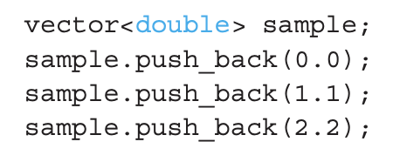
Vector Use
vector<int> v;
"v is vector of type int"
Calls a class default constructor
Empty vector object is created
Elements are indexed just like arrays for access
E.g.) v[i]=42, cout << v[i];
One restriction: v[i] notation is used to change the value that has already been given some value
To add new elements:
Call member function push_back()
Member function size()
Returns the current number of elements

Slide 44
Vector Use
Constructor call for vector
vector<int> v(10);
Will initialize the vector of size 10 (with zeros)
When the base type is a class type, the default constructor will be used.

Slide 45
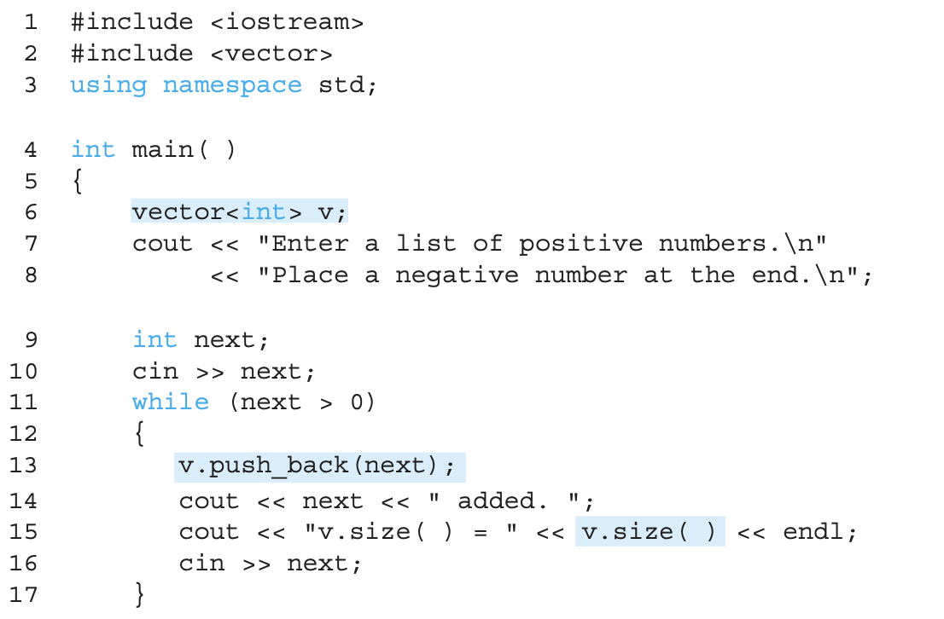
Vector Example: Display 7.7 Using a Vector (1 of 2)

Slide 46
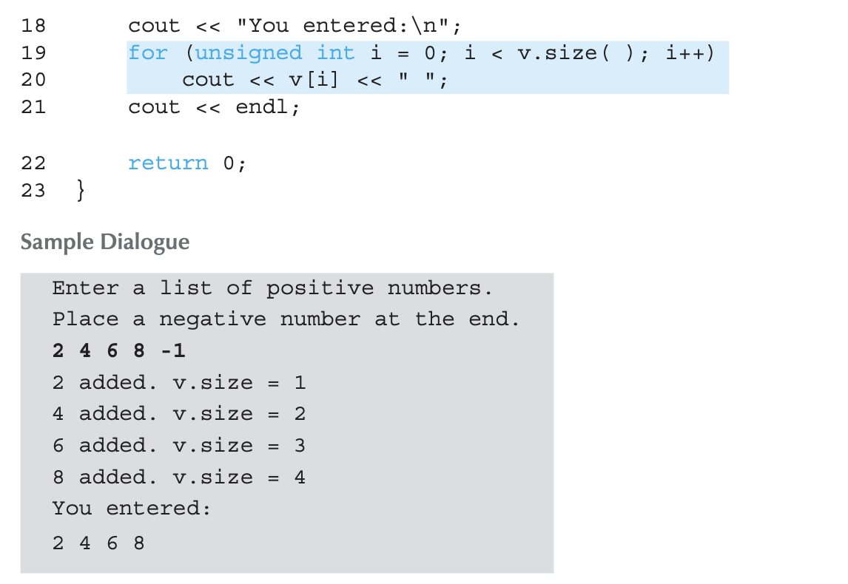
Vector Example: Display 7.7 Using a Vector (2 of 2)

Slide 47
Summary 1
Constructors: automatic initialization of class data
Called when objects are declared
Constructor has same name as class
Default constructor has no parameters
Should always be defined
Class member variables
Can be objects of other classes
Require initialization-section

Slide 48
Summary 2
Constant call-by-reference parameters
More efficient than call-by-value
Can inline very short function definitions
Can improve efficiency
Static member variables
Shared by all objects of a class
Vector classes
Like: "arrays that grow and shrink"

Slide 49
Thank you!
Web: http://mindlab-snu.github.io
E-mail: tsmoon@snu.ac.kr

